Slide 1
Full Custom IC
Final Report
By Seokchan Kang
University of Seoul
School of Electrical and Computer Engineering

Slide 2
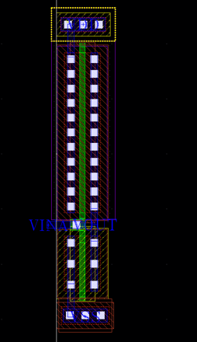
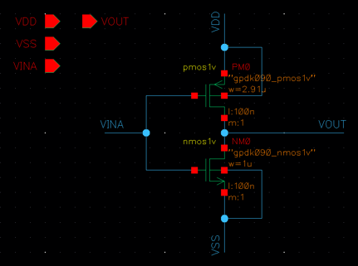
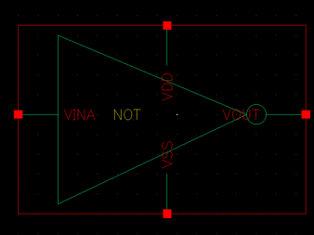
NOT gate
<Schematic>
<Symbol>
<Layout>

Slide 3
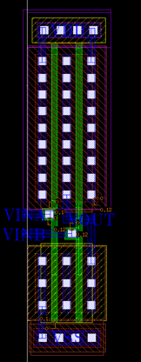
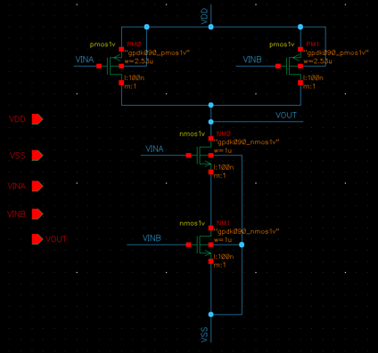
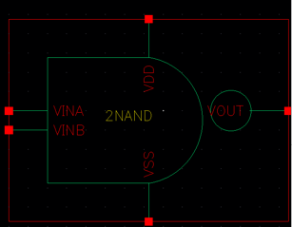
2-input NAND gate
<Schematic>
<Symbol>
<Layout>

Slide 4
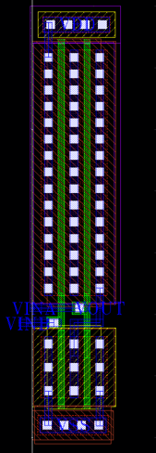
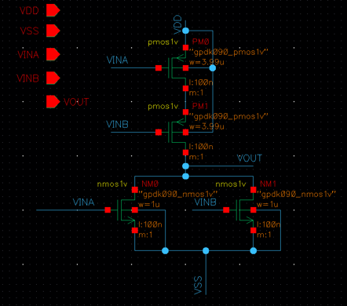
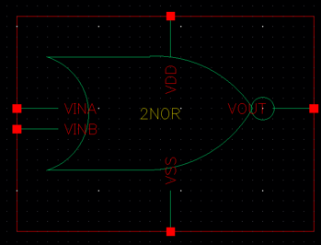
2-input NOR gate
<Schematic>
<Symbol>
<Layout>

Slide 5
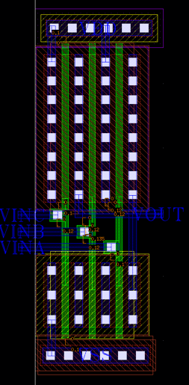
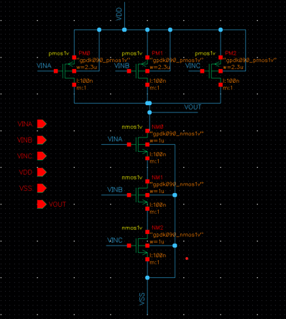
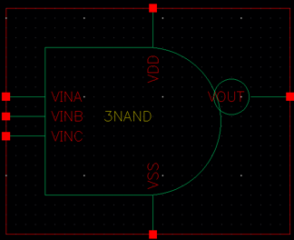
3-input NAND gate
<Schematic>
<Symbol>
<Layout>

Slide 6
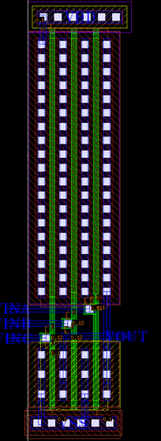
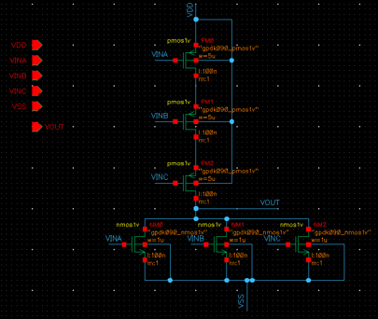
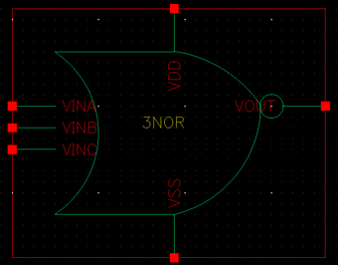
3-input NOR gate
<Schematic>
<Symbol>
<Layout>

Slide 7
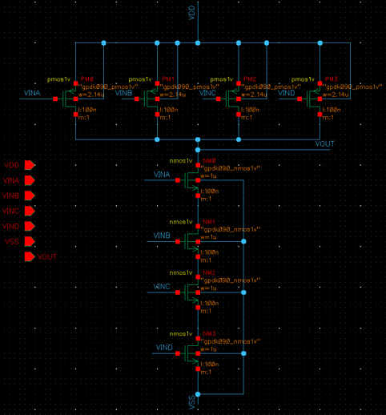
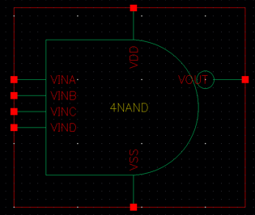
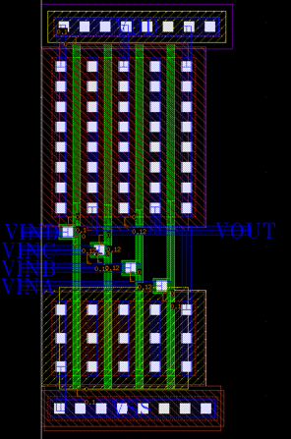
4-input NAND gate
<Schematic>
<Symbol>
<Layout>

Slide 8
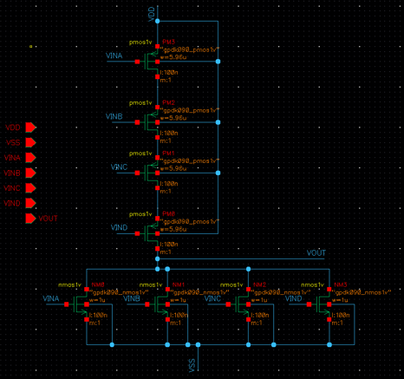
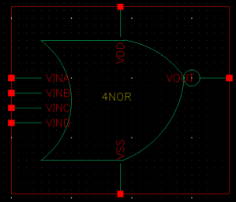
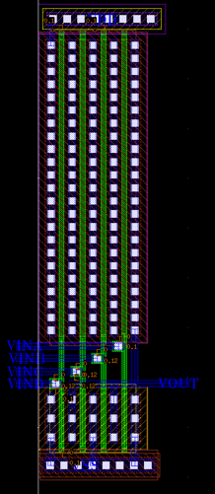
4-input NOR gate
<Schematic>
<Symbol>
<Layout>

Slide 9
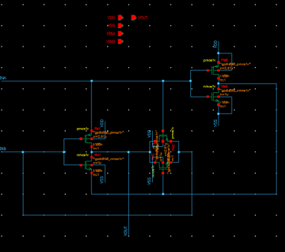
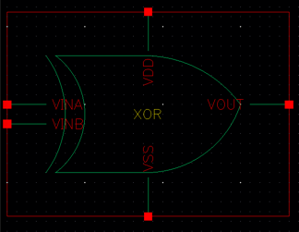
XOR gate (1)
University of Seoul
<Schematic>
<Symbol>

Slide 10
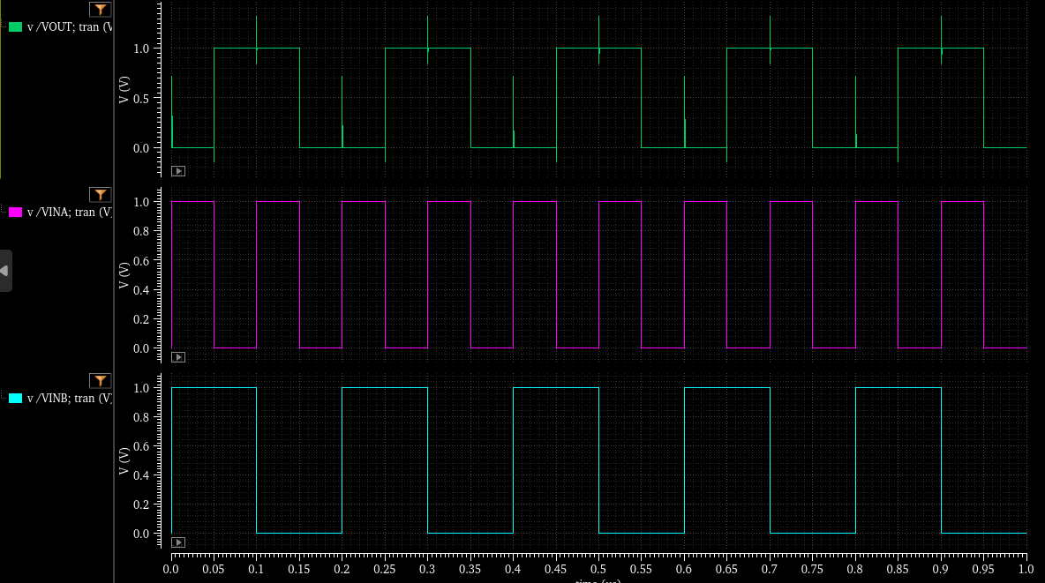
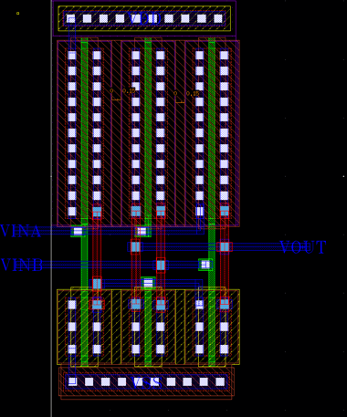
XOR gate (2)
University of Seoul
<Simulation>
<Layout>

Slide 11
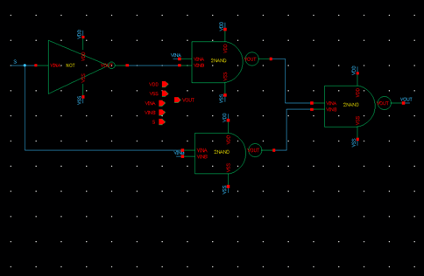
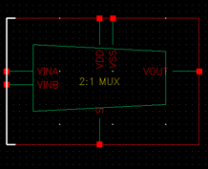
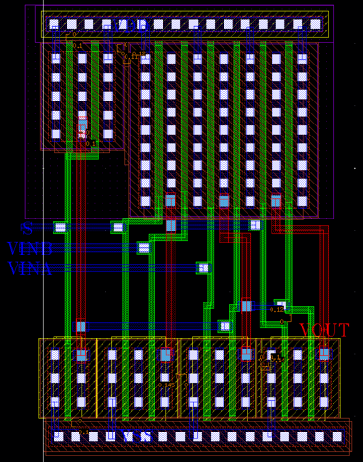
2:1 MUX _ LOGIC
University of Seoul
<Schematic>
<Symbol>
<Layout>

Slide 12
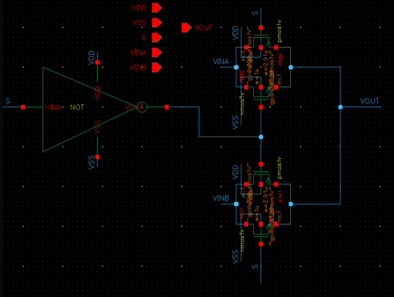
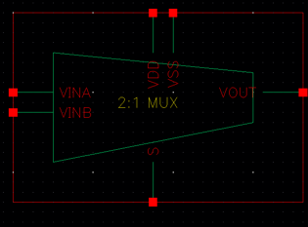
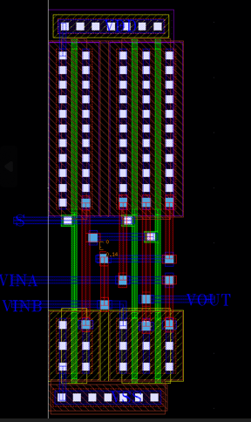
2:1 MUX _ Switch
University of Seoul
<Schematic>
<Symbol>
<Layout>

Slide 13
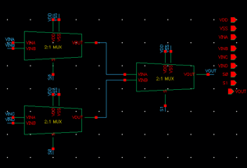
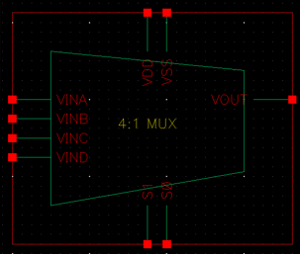
4:1 MUX _ LOGIC (1)
University of Seoul
<Schematic>
<Symbol>

Slide 14
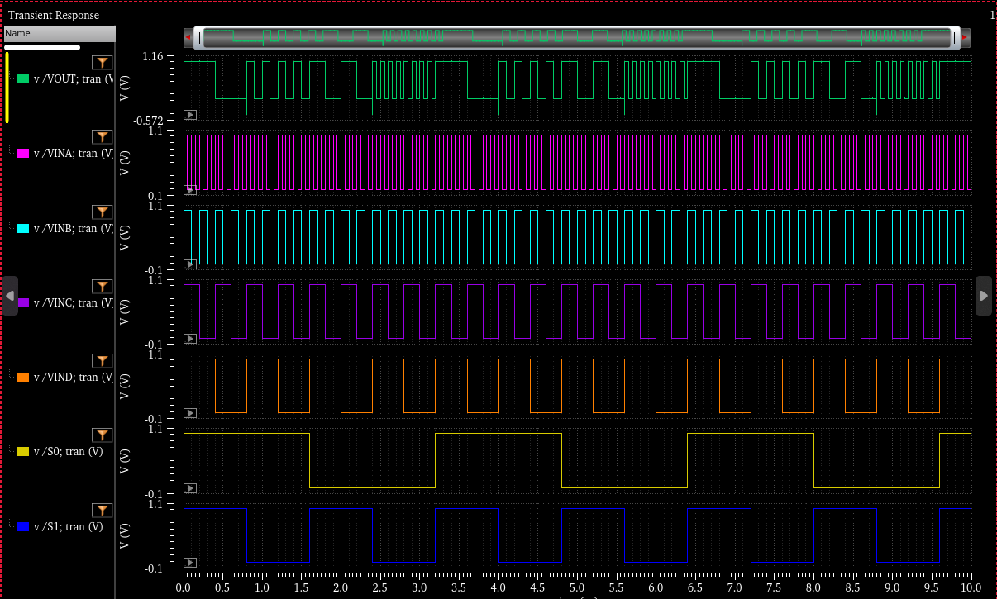
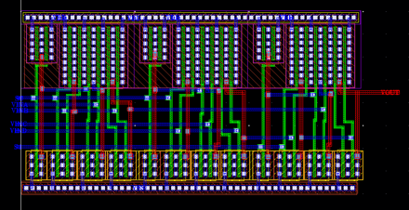
4:1 MUX _ LOGIC (2)
University of Seoul
<Simulation>
<Layout>

Slide 15
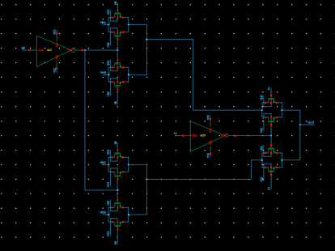
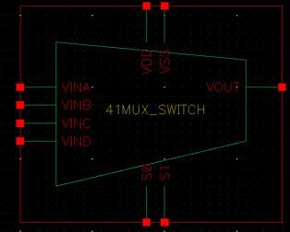
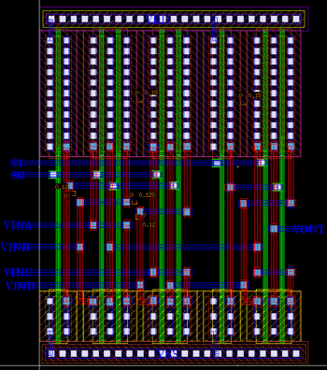
4:1 MUX _ Switch
University of Seoul
<Schematic>
<Symbol>
<Layout>

Slide 16
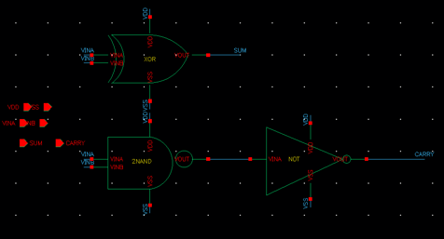
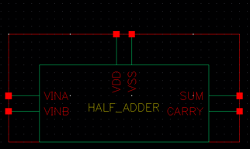
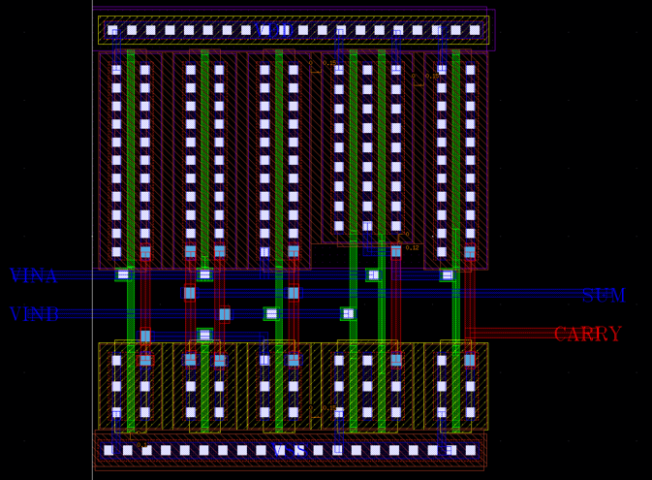
HALF ADDER
University of Seoul
<Schematic>
<Symbol>
<Layout>

Slide 17
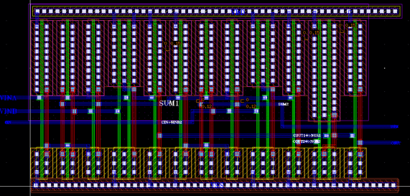
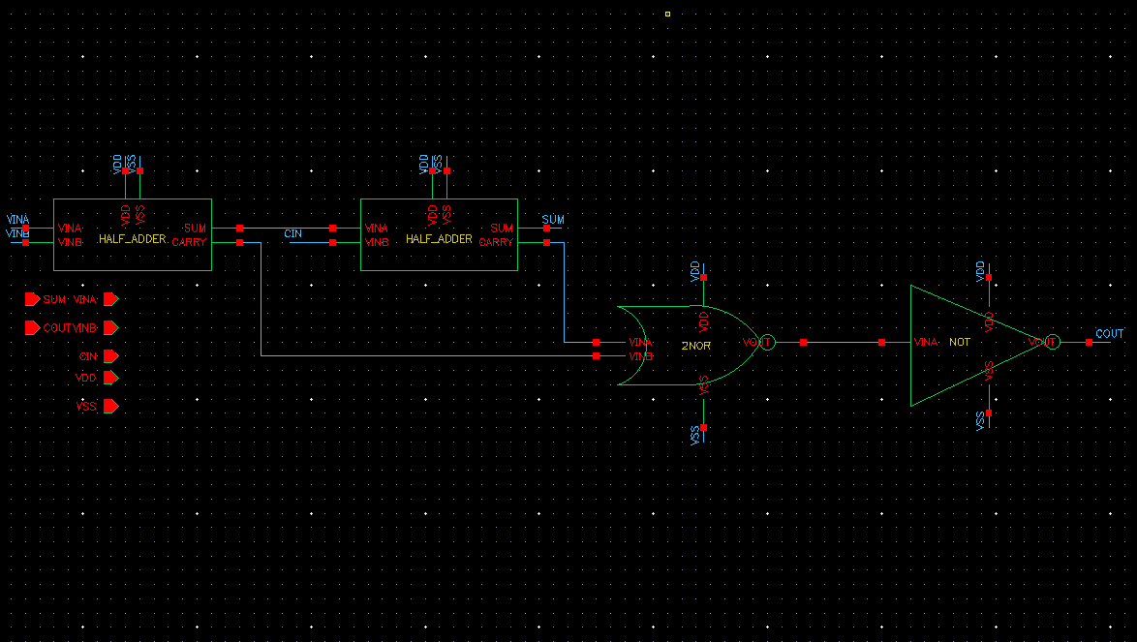
FULL ADDER
University of Seoul
<Schematic>
<Layout>

Slide 18
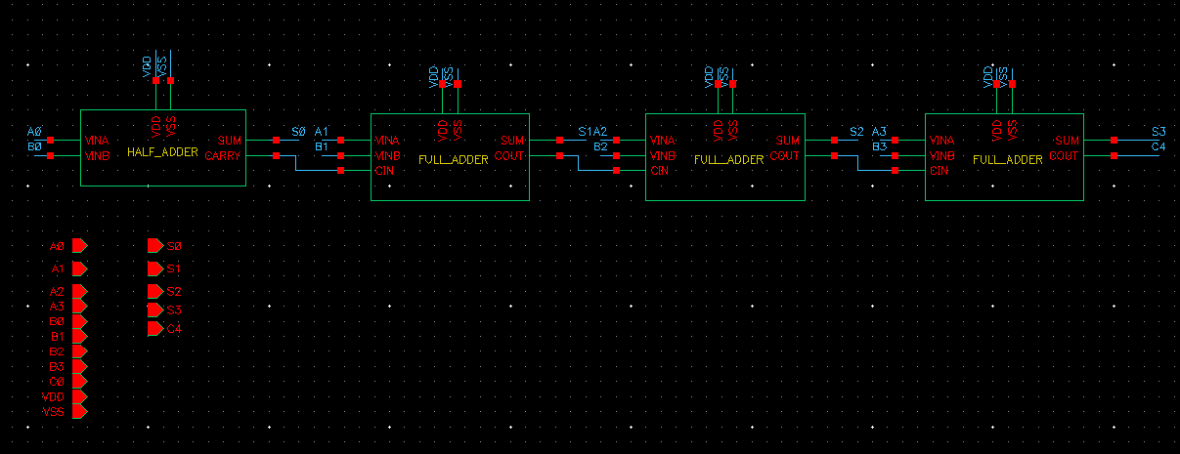
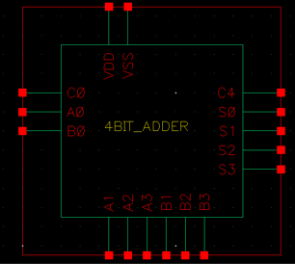
4-BIT ADDER (1)
University of Seoul
<Schematic>
<Symbol>

Slide 19
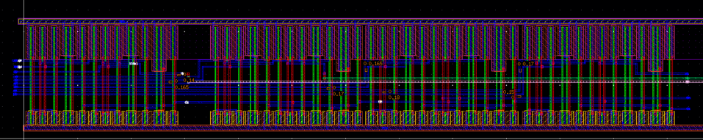
4-BIT ADDER (2)
University of Seoul
<Layout>

Slide 20
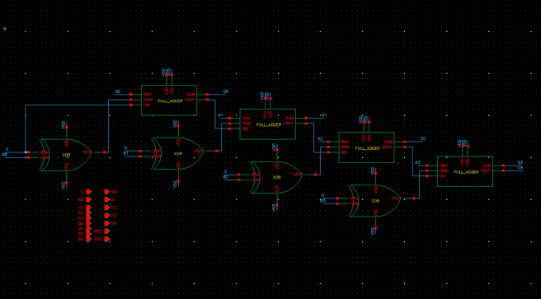
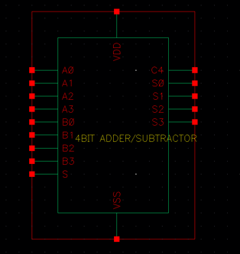
4-BIT ADDER/SUBTRACTOR (1)
University of Seoul
<Schematic>
<Symbol>

Slide 21
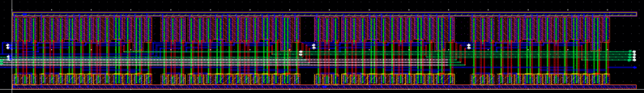
4-BIT ADDER/SUBTRACTOR (2)
University of Seoul
<Layout>

Slide 22
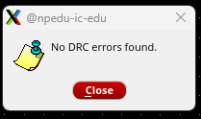

Design Verification
University of Seoul
<DRC>
<LVS>

Slide 23
Thank you!
University of Seoul

